Slide 1


An Ensemble Machine Learning Model to Classify Literary Writers’ Perspective on Anxiety, Stress, and Trauma in War Narratives by Middle Eastern Women
Student: Zhao Dan (P-COM0255/20)
Supervisor: Ts. Dr. Pantea Keikhosrokiani
Mentor: Dr. Moussa Pourya Asl

Slide 2

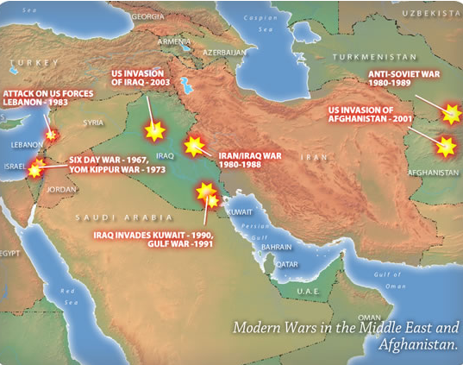
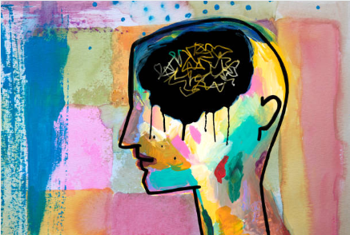
Project Introduction
School of Humanity in USM (Univerisiti Sains Malaysia) is one school whose research area covers a wide spectrum of disciplines that include philosophy, civilization, religion, language, literature, history, geography, and translation.
The Middle East is a geographical term that mainly includes the Arab Peninsula, Egypt, and a part of West Asia. Some Middle East countries suffer from invasions and civil wars since the last century. It is common sense that wars have a negative effect on mental health, and some negative sentiments are usually tied to wars. This project will apply machine learning techniques to classify three chosen sentiments, stress, trauma, and anxiety from war narratives in the middle east.

Slide 3
Problem statement
The existing research on negative sentiments in the middle east war is of scarcity, and I’d like to work on it to study stress, trauma, and anxiety in the middle eastern war narratives.
Classifying the sentiments all manually can be time-consuming and sometimes unrealistic. I’d like to develop a hybrid method to classify stress, trauma, and anxiety.
The studies in text classification for literary works is quite limited, which causes difficulties to choose algorithm and methods. I’d like to tune multiple algorithms, parameters, and techniques to find the optimal model.

Slide 4

Research Problems
How to assign the correct sentiment to each sentence?
What preprocessing should be done before applying the machine learning techniques?
How to apply machine learning techniques?
What is the optimal model and how to interpret the results?
Objectives
To identify the keywords that related to stress, trauma, and anxiety and create the dictionary respectively.
To get the data ready for machine learning models by following five steps, tokenization, normalization, punctuation removal, stopwords removal, and POS tag.
To apply the individual machine learning algorithsm and ensemble learning techniques in python environment, and compare the models.
To identify the evaluation metrics used, visualize the results, select the optimal model, and interpret the results from technical and domain aspect.

Slide 5
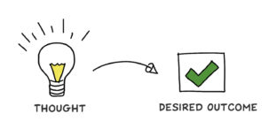
Expected outcomes
Solve the research problems mentioned.
Successfully implement the machine learning algorithms and techniques.
Generate an optimal model that is reliable and stable.
Discuss and reflect on the technical and domain results.

Slide 6
Literary review-Domain perspective
Concept of stress, trauma, and anxiety
Stress is “mental pressure or worry caused by problems in somebody’s life or by having too much to do”
Anxiety is “the state of feeling nervous or worried that something bad is going to happen”
Trauma is “a mental condition caused by severe shock, stress or fear, especially when the harmful effects last for a long time”
Stress, trauma, and anxiety in war narratives
As a form of literature that has a context of war, war narratives have a trajectory that is accompanied by an emotional progression.
Stress, trauma, and anxiety in war narratives, in most cases, are associated with events such as threats to life and limb; loss of friends; exposure to the death and dying of others; physical and mental symptoms caused by anxiety, etc.

Slide 7
Literary review-Machine Learning perspective
Text Classification with individual algorithm
Paper Title | Description | Algorithm Used | Accuracy Score Obtained
Sentiment Analysis Framework of Twitter Data Using Classification (Khurana, M, 2018) | Classify the twitter post into positive, neutral, and negative using NB, SVM, and RF. | Naïve bayes (NB), Support Vector Machine (SVM), and Random Forest (RF) | NB (88%), SVM (81%), RF (63%)
Patent Text Classification based on Naive Bayes Method (Xiao, L, 2018) | Classify the patent to A, E, F, H using NB and SVM | Naïve Bayes (NB), and Support Vector Machine (SVM) | NB (98.6%), SVM (96%) * *Take the first class as example.
Sentiment Analysis on Movie Review Data Using Machine Learning Approach (Rahman, A, 2019) | Classify the movie to four classes using NB, SVM, and DT | Multinomial Naïve Bayes (MNB), Bernoulli Naïve Bayes (BNB), Support Vector Machine (SVM), and Decision Tree (DT) | MNB (88.5%), BNB (87.5%), SVM (87.3%), and DT (80.17%)
Study on SVM Compared with the other Text Classification Methods (Liu, Z, 2019) | Classify the input data to four classes using KNN, NB, and SVM | K-Nearest Neighbor (KNN), Naïve Bayes (NB), Support Vector Machine (SVM) | KNN (97.44%), NB (95.92%), SVM (97.31%).

Slide 8
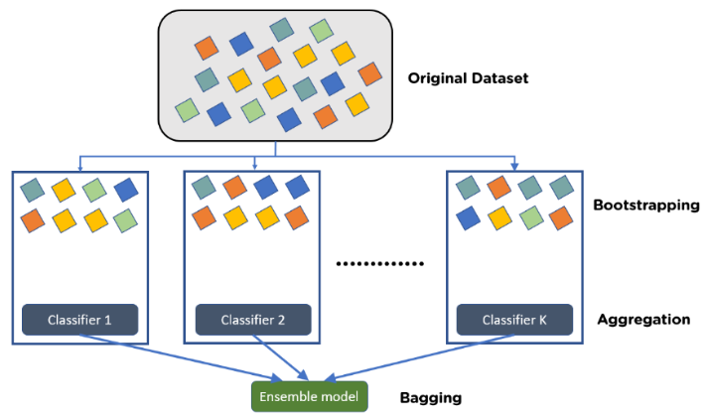
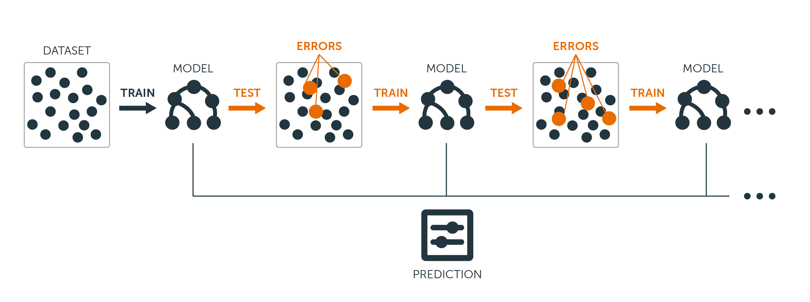
Literary review-Machine Learning perspective
Text Classification with Ensemble Learning Techniques
Bagging
Boosting

Slide 9
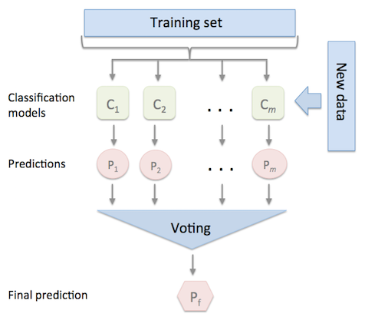
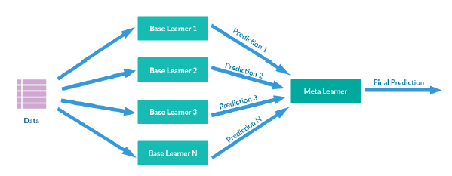
Literary review-Machine Learning perspective
Text Classification with Ensemble Learning Techniques
Voting
Stacking

Slide 10
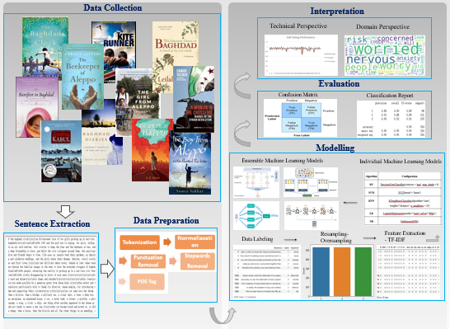
Project Framework

Slide 11
Data Understanding
No. | Name | Description | Writer
1 | The Baghdad Clock | A tale of two friends growing up during the first and second Iraqi war | al Rawi, Shahad
2 | Baghdad Diaries 1991-2002_ A Woman's Chronicle of War and Exile | Author’s diary started from 1991 during the first Gulf war | al Rawi, Shahad, Nuha
3 | The Beekeeper of Aleppo_ A Moving Testament to the Human Spirit | A beekeeper who was forced to flee away from Syria | Lefteri, Christy
4 | The Girl from Aleppo_ Nujeen's Escape from War to Freedom | A disabled girl escape from Syria to Germany | Mustafa, Nujeen
5 | The Orange Trees of Baghdad_ In Search of My Lost Family_ A Memoir | A story from the author about her immigration experience | Nadir, Leilah

Slide 12
Data Understanding – Cont.
No. | Name | Description | Writer
6 | Barefoot in Baghdad | A story about a lady moves to Iraq to help as many women as she can rebuild their lives | Omar, Manal M
7 | Escape from Aleppo | A story about a family in Syria flees to safety | Senzai, N H
8 | Shooting Kabul | A story about a family flees from Afghanistan to the U.S. | Senzai, N H
9 | The Boy from Aleppo Who Painted the War | A story about a boy who attempts to understand the Syrian conflict and its effect on his life by painting his feelings | Sukkar, Sumia
10 | A Woman in the Crossfire_ Diaries of the Syrian Revolution | A story about the author on how she struggles to protect herself and her young daughter in the war | Yazbek, Samar

Slide 13
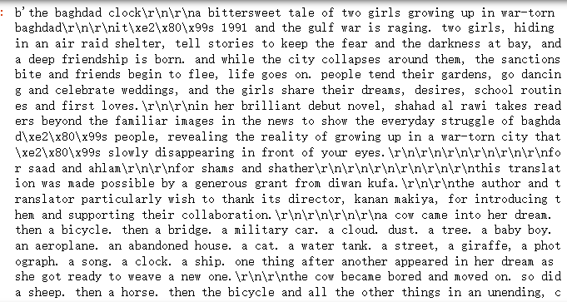
Sentence Extraction
The extracted text data is shown in the right

Slide 14
Data Preparation
Tokenization
Normaliazation
Punctuation Removal
Stopwords
Removal
POS Tag
Breaking text data into sentences, words, or short phrases
Standardization of tokens, and it usually consists of lemmatization, stemming, and lowercase.
Including text punctuation and special symbol
Stopword are meaningless words, most of them are small words like preposition, pronoun, modals, and etc.
Assigning categorical tags to tokens based on the syntactic functions of the tokens.

Slide 15
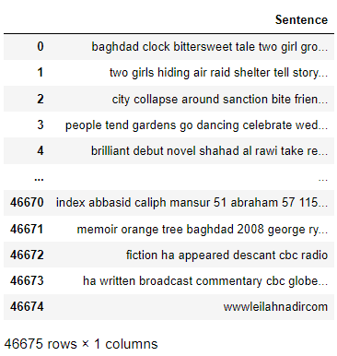
Prepared Data
The prepared dataset is shown in the right

Slide 16
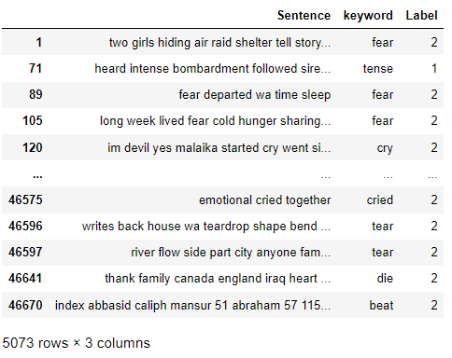
Data Labeling
Class | Words Related
stress (1) | stress, stressed, stresses, stressing, stressful, stressfully, tension, tense, tensed, tensing, nervous, nervously, nervousness, pressure, pressures, pressuring, pressurize, pressurized, threat, threaten, threatened, threatening, threatens, threateningly, tightness, tight, tighten, tightens, tightening, tightened, intensity, tensity, forced, strain, strains, strained, straining, tenseness
trauma (2) | agony, trauma, traumatized, traumatise, traumatised, traumatises, traumatising, traumatizing traumatize, traumatizes, traumatic, traumatically, offense, offend, offended, offends, abuse, abuses, abused, abusive, abusively, insult, insults, insulted, insulting, insultingly, affront, affronted, affronts, affronting, torture, tortures, tortured, torturing, massacre, massacred, massacres, massacring, tragedy, tragedies, tragic, tragical, tragically, beat, beaten, beating, beats, kill, kills, killing, distress, distressed, distressing, sorrow, sorrowful, sorrowfully, distressful anguish, anguishes, anguished, anguishing, torment, tormented, torments, tormenting,
anxiety (3) | anxiety, anxieties, anxious, anxiously, worry, worries, worried, worrying, concern, concerns, concerned, agitation, agitate, agitated, agitates, perturbation, perturbative, perturb, perturbed, perturbs, panic, panicked, panicking, panics, disquiet, disquiets, disquieting, disquieted, disquietingly, disquietude, risk, risks, risky, could be killed, would be killed, angst, agonize, agonizes, agonized, agonizing, unease, uneasy, uneasily, restless, troublous, unrestful, jittery, jitteriness, panicky, uptight, apprehensive, apprehensiveness, apprehensively, restlessness,
Labeled Dataset Output

Slide 17
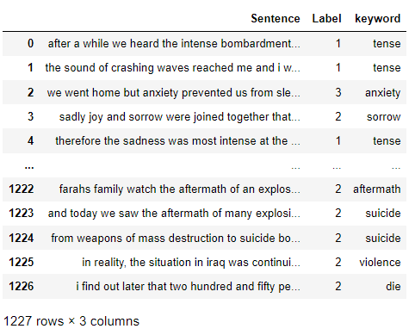
Data Labeling-cont.
Manual Labeled Dataset Output

Slide 18
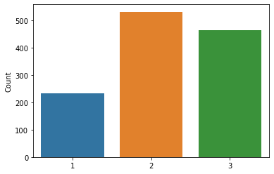
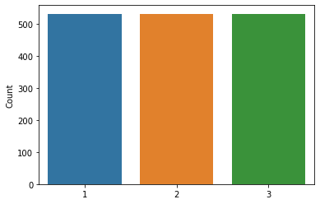
Data Resampling
Resampling the data as the classes are not perfectly balanced.
Classes Distribution before resampling
Classes Distribution after resampling

Slide 19
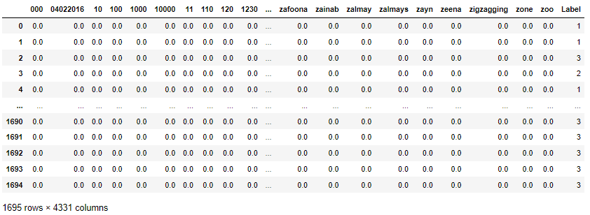
Feature Extraction (TF-IDF)
TF-IDF is a method for determining the meaning of sentences made out of words that overcomes the limitations of the Bag of Words technique.

Slide 20
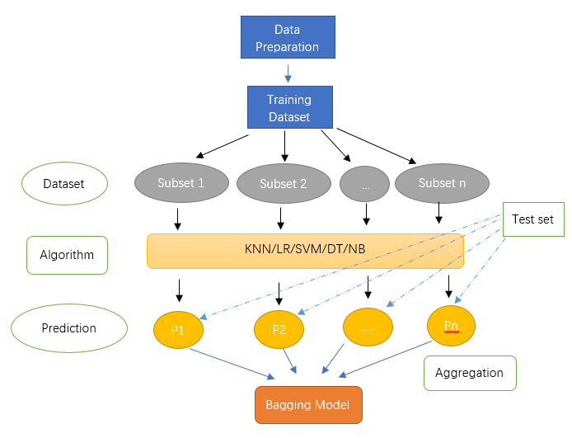
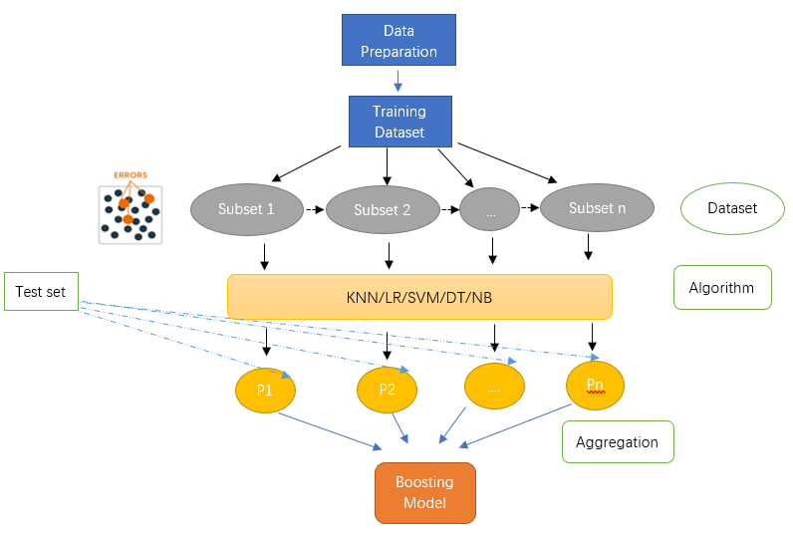
Modeling – Ensemble Learning
Bagging Architecture
Boosting Architecture

Slide 21
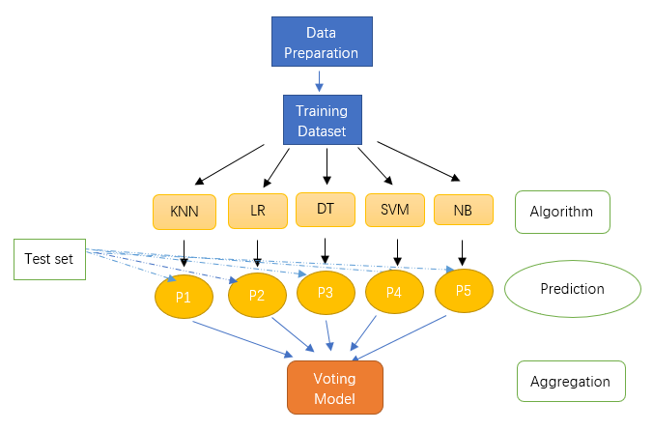
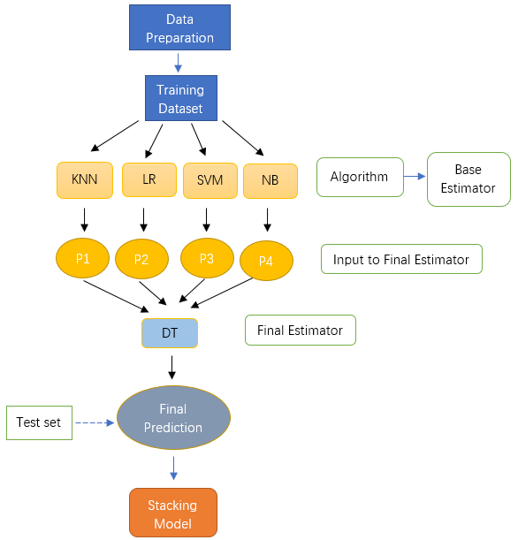
Modeling – Ensemble Learning
Stacking Architecture
Voting Architecture

Slide 22
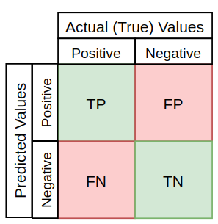
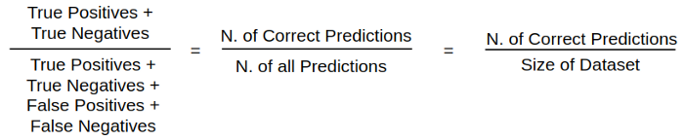
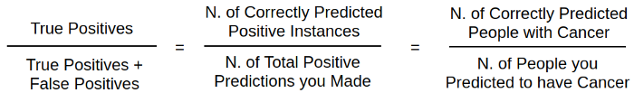
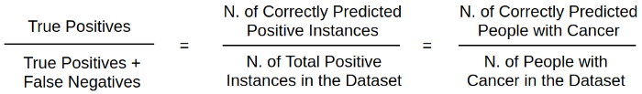
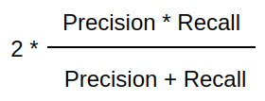
Metrics | Formula
Accuracy Score
Precision
Recall
F1-score
Model Evaluation

Slide 23
Results – Top 5 Individual Model
Algorithm | Configuration | Accuracy Score
DT | DecisionTreeClassifier(criterion = 'gini', max_depth = 8) | 0.636
SVM | SVC(kernel = 'linear') | 0.935
KNN | KNeighborsClassifier(algorithm="auto", weights="distance", n_neighbors = 20) | 0.820
LR | LogisticRegression(penalty="none",solver="lbfgs") | 0.923
NB | MultinomialNB() | 0.897
Individual Algorithm:
There are five algorithms chosen, and are DT (Decision Tree), SVM (Support Vector Machine), KNN (K-Nearest Neighbor), LR (Logistic Regression), and NB (Naïve Bayes).
After tuning the hyperparameters, the optimal models can be found on the right.

Slide 24
Technique | Configuration | Accuracy Score
Stacking | model_stacking = StackingClassifier(estimators = [('dt', clf1),('svm', clf2), ('mnb',clf5)], \final_estimator = linear_model.LogisticRegression(penalty="none",solver="lbfgs“)) | 0.947
Voting | model_voting = VotingClassifier(estimators = [('svm', clf2), ('knn', clf3),('mnb', clf5)], \voting = 'soft') | 0.944
Voting | model_voting = VotingClassifier(estimators = [('svm', clf2),('mnb', clf5)], \voting = 'soft') | 0.941
Stacking | model_stacking = StackingClassifier(estimators = [('dt', clf1),('svm', clf2),('knn', clf3), ('mnb',clf5)], \final_estimator = linear_model.LogisticRegression(penalty="none",solver="lbfgs)) | 0.941
Stacking | model_stacking = StackingClassifier(estimators = [('dt', clf1),('svm', clf2)], \final_estimator = linear_model.LogisticRegression(penalty="none",solver="lbfgs")) | 0.935
Results – Top 5 Ensembled Model
Ensemble Learning Technique:
There are four techniques applied in this part, and they are bagging, boosting, voting, and stacking.
After using the optimal individual algorithm as the input, the top 5 models generated are shown on the right.

Slide 25
Results & Discussion - Model Comparison in Accuracy Score
Individual Algorithms
Ensemble Learning
Algorithm | Average Score | Highest Score | Hyperparameter List
SVM | 0.919 | 0.935 | kernel, degree, gamma, C
LR | 0.923 | 0.923 | penalty, solver
NB | 0.832 | 0.897 | gaussian, bernoulli, multinomial
KNN | 0.782 | 0.820 | n_neighbors, algorithm, weights,
DT | 0.611 | 0.636 | criterion, max_depth
Technique | Average Score | Highest Score | Hyperparameter List
Bagging | 0.850 | 0.929 | base_estimator, n_estimators
Boosting | 0.774 | 0.917 | base_estimator, n_estimators
Hard Voting | 0.877 | 0.929 | estimators, voting
Soft Voting | 0.919 | 0.944 | estimators, voting
Stacking | 0.889 | 0.947 | estimators, final_estimator

Slide 26
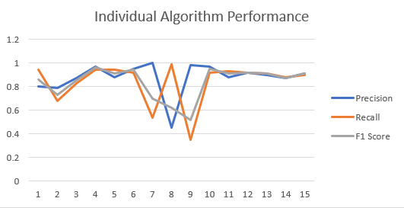
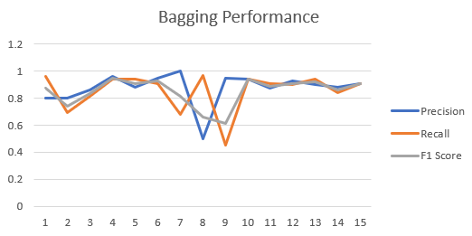
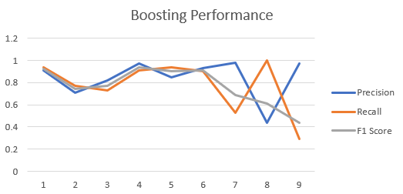
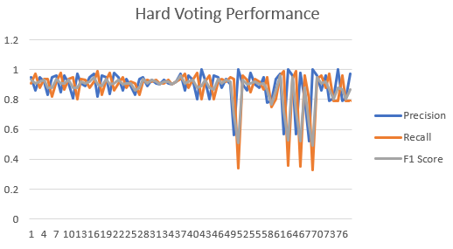
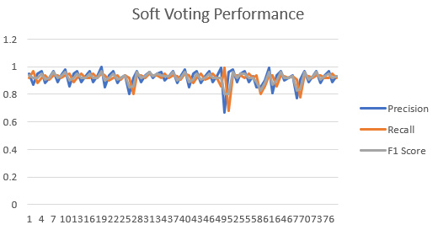
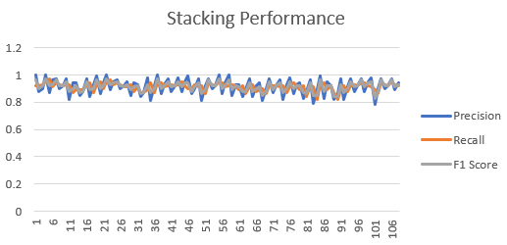
Results & Discussion - Model Comparison in Precision, Recall, and F1-score

Slide 27
Results & Discussion – Interesting Modelling Phenomena
Technique | Combination | Class | Precision | Recall | F1-Score | Accuracy
 |  | 1 | 0.98 | 0.53 | 0.69
Boosting | MNB | 2 | 0.44 | 1.00 | 0.61 | 0.590
 |  | 3 | 0.97 | 0.29 | 0.44
 |  | 1 | 1.00 | 0.54 | 0.70
Stacking | DT, SVM*** | 2 | 0.45 | 0.98 | 0.62 | 0.616
 |  | 3 | 0.96 | 0.36 | 0.72
 |  | 1 | 0.99 | 0.61 | 0.75
Stacking | DT, LR*** | 2 | 0.46 | 0.98 | 0.63 | 0.631
 |  | 3 | 0.96 | 0.34 | 0.51
 |  | 1 | 0.98 | 0.54 | 0.70
Stacking | DT, KNN*** | 2 | 0.44 | 0.98 | 0.61 | 0.602
 |  | 3 | 0.95 | 0.32 | 0.48
Underperformed Ensemble Learning Models Samples
There will be times that the ensemble learning model underperformed the individual. It is more likely to be happened when the performance of individual algorithms is already good enough, and the trials are not enough.

Slide 28
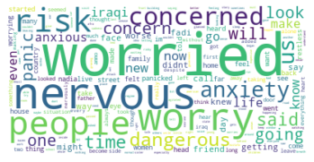
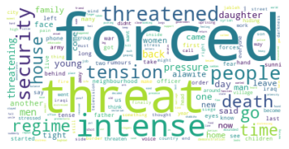
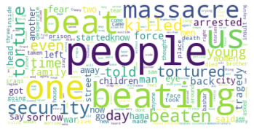
Results & Discussion – Sentiments Specific
Anxiety
Stress
Trauma

Slide 29
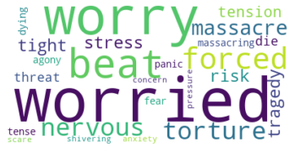
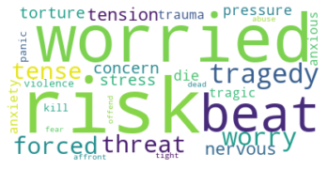
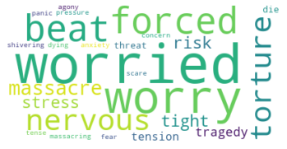
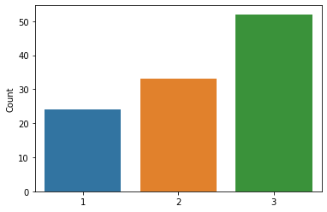
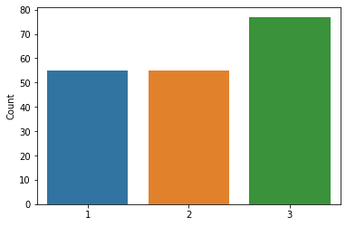
Results & Discussion – Novel Specific
The Beekeeper of Aleppo
The Girl from Aleppo
The Orange Trees of Baghdad

Slide 30
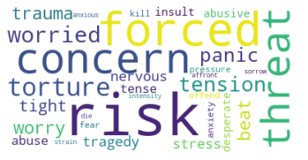
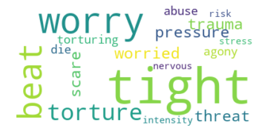
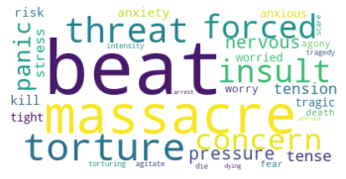
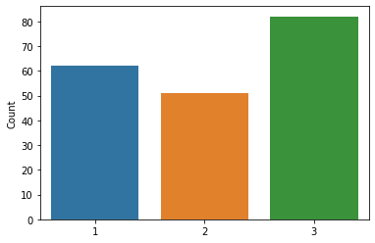
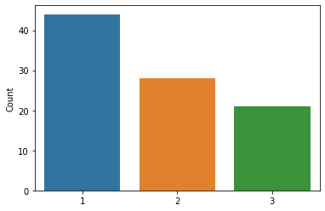
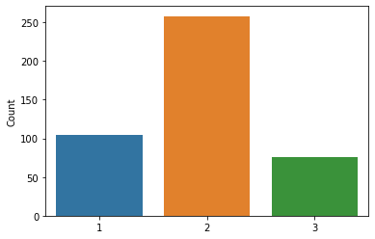
Results & Discussion – Novel Specific-Cont.
Barefoot in Baghdad
The Boy from Aleppo
Diaries of the Syrian Revolution

Slide 31
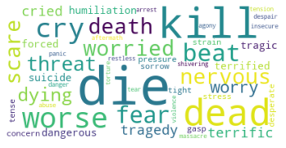
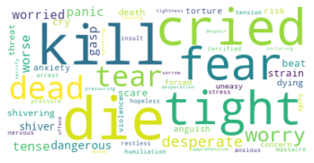
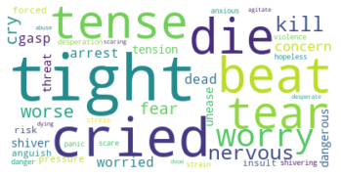
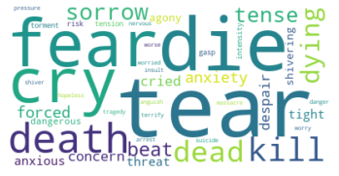
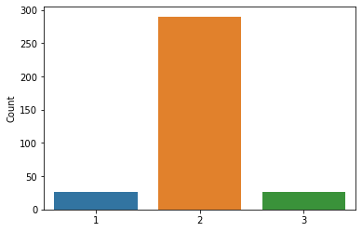
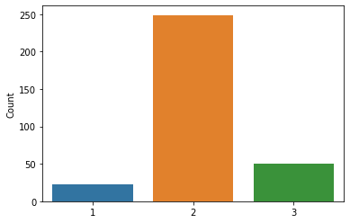


Results & Discussion – Novel Specific-Cont.
The Baghdad Clock
Baghdad Diaries
Escape from Aleppo
Shooting Kabul

Slide 32
Conclusion
Technical Aspect
This study generated a bunch of models in a python environment and analyzed the performances of both individual and ensembled machine learning models. The optimal model generated has an accuracy score as high as 0.947, and the model was from the stacking technique. Overall, the ensemble learning technique has outperformed individual algorithms in terms of accuracy score, precision, recall, and F1-value, and the most stable and reliable models are from soft voting and stacking. Besides, there are two interesting insights I discovered during the modeling process
Domain Aspect
Writers’ perspective toward stress, trauma, and anxiety based on the classification results has been revealed too. Writers have an overall emphasis on the sentiment of trauma. Although novels tell different stories, their writers use similar words to depict stress, trauma, and anxiety. Different novels have different emphasized sentiments, while all three sentiments are included. Overall, writers believe wars impose stress, trauma, and anxiety on people, and the sentiment of trauma is the most noticeable one of all.

Slide 33
Challenges & Solutions
1.Unfamiliar preparation steps for text analysis.
Solution: Learn from previous works, online channels and resources, and ask for guidance from supervisor to explore the preprocessing steps such as tokenization, stopwords removal, etc.
2. Data labeling.
Solution: Adopt hybrid method to label the data. Build a keyword dictionary, and label the data according to the keyword. Then, manually read and label the selected sentence according to the meaning of the sentence. The manually assigned label will be the final label of the sentences.
3. Model selection & results interpretation
Solution: Select the models based on Accuracy Score, Precision, Recall, and F1-Score, the higher the value of the metric, the better the performance. And then, I interpret the results from modelling and sentiments aspects, and come to the conclusion from technical and domain aspects.

Slide 34
Lesson Learning
I learned how to perform text classification and analysis, and these include labeling the data, refine the models, and interpret the results.
I learned the importance of the domain knowledge, and results interpretation
I also learned the brutal nature of wars, and how people suffer from stress, anxiety, and trauma in a war.
Future Works
There is still more that awaits us to explore.
Firstly, there are many negative sentiments can be detected from the war narratives. Apart from stress, trauma, and anxiety, other sentiments such as fear, and anger are also worth exploring.
Secondly, manually labeling all the data might be more recommended due to the complex nature of human language when time and manpower allow.
Finally, the performance of the ensemble learning models varies from one algorithm combination to another. More algorithms can be added, tuned, and combined to potentially find a model with even better performances.

Slide 35


